Slide 1
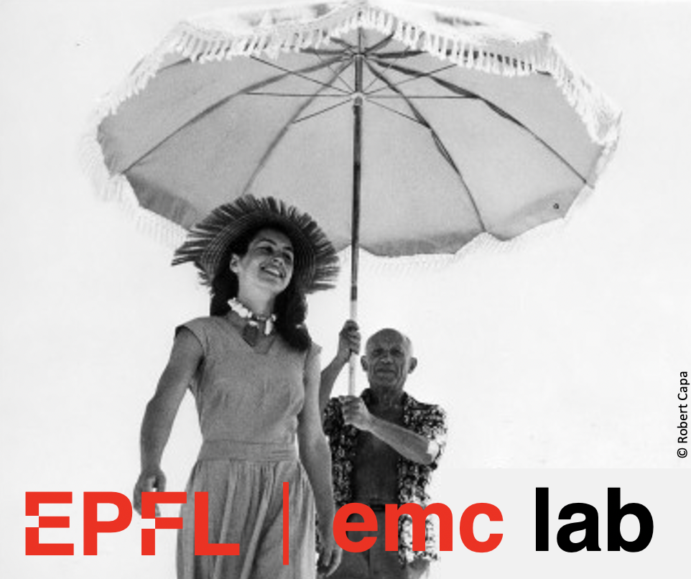
Electromagnetic Compatibility
F. Rachidi
École Polytechnique Fédérale de Lausanne
EMC Laboratory
Farhad.Rachidi@epfl.ch
http://emc.epfl.ch

Slide 2
Suggested References
Tesche, F. M., M. Ianoz and T. Karlsson, EMC Analysis Methods and Computational Models, John Wiley and Sons, New Work, 1997.
Paul, C. R., Introduction to Electromagnetic Compatibility, John Wiley & Sons, New York, 12006.
Ott, H., Electromagnetic Compatibility Engineering, Wiley Interscience, 2009.
Notes:
It’s a very broad discipline ranging from nano and microelectronics to communications and power systems.
Sources of interference can be natural or man-made

Slide 3
Course Outline
Introduction to EMC
EM Coupling and Crosstalk
LF Coupling Mitigation Techniques
Grounding, Balancing and Filtering
Electromagnetic Shielding
Lightning
Digital Circuits – PCB Layout
Notes:
It’s a very broad discipline ranging from nano and microelectronics to communications and power systems.
Sources of interference can be natural or man-made

Slide 4
Course Evaluation
Homeworks (bonus)
Assignments
Three lab sessions
Final test
Notes:
It’s a very broad discipline ranging from nano and microelectronics to communications and power systems.
Sources of interference can be natural or man-made

Slide 5
Date | Programme
20.02 | Introduction to EMC, Coupling Modes
21.02 | Electromagnetic Coupling 1
27.02 | Electromagnetic Coupling 2
28.02 | Problem Set 1
06.03 | Frequency domain solutions
07.03 | Time domain solutions
13.03 | Problem Set 2
14.03 | Two-port representation of TLs
20.03 | Lab 1: Characterization of TLs using s-parameters (MED2 2419)
21.03 | Electromagnetic crosstalk: 3-conductor lines
27.03 | Solutions for multiconductor lines
28.03 | Problem Set 3
03.04 | Electromagnetic crosstalk: Inductive and capacitive coupling
04.04 | Lab 2: EM coupling and crosstalk (MED2 2419)
10.04 | Low Frequency Coupling Mitigation (shielded cables, twisted pairs)
11.04 | Problem Set 3
17.04 | EM shielding
01.05 | Lab 3: Coupling mitigation (MED2 2419)
02.05 | Coupling to shielded cables
08.05 | Problem Set 4
09.05 | Grounding, Filtering and Balancing
15.05 | Lightning phenomenon
16.05 | Lightning protection on power lines
22.05 | EMC in digital circuits
23.05 | Problem Set 5
30.05 | Final Test

Slide 6
Course Material
Moodle
Notes:
It’s a very broad discipline ranging from nano and microelectronics to communications and power systems.
Sources of interference can be natural or man-made

